Slide 1



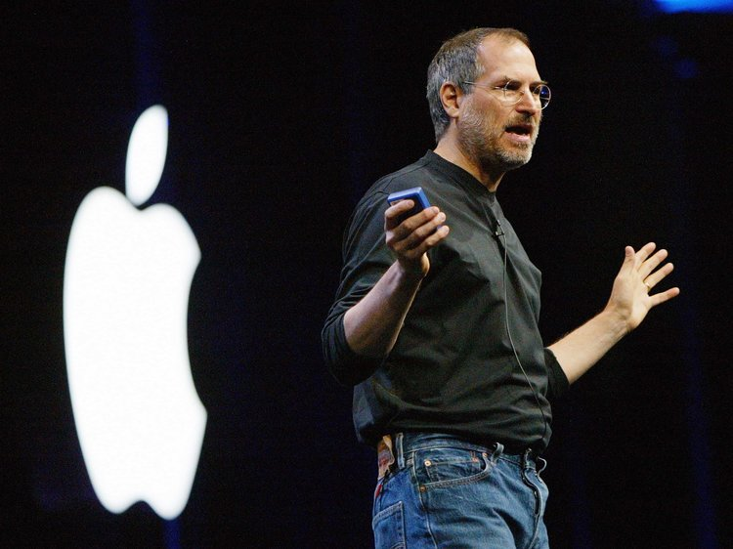

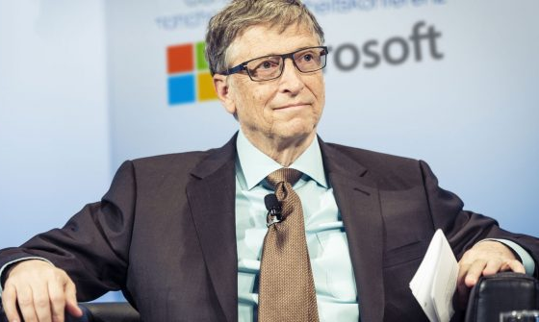
Do You Know These Personalities?
entrepreneurs
Notes:
Walt Disney started off as a farm boy drawing cartoon pictures of his neighbor's horses for fun.
When he was older, Walt tried to get a job as a newspaper cartoonist, but was unable to find one and ended up working in an art studio where he created ads for newspapers and magazines.
Eventually he grew to work on commercials, became interested in animation, and eventually opened his own animation company.
---------------------------------------------
Today J.K. Rowling is a household name for fans of the beloved Harry Potter book series, but she wasn't always gifted with magic.
The fact is, J.K Rowling was at her rope's end before her misfit gang of witches and wizards saved her.
Before her bestseller cast a spell on readers, J.K. Rowling was living on welfare and struggling to get by as a single mother.
---------------------------------------------
Otara Gunewardene is a Sri Lankan entrepreneur and the Founder of Odel and Embark. Otara loves for retail and fashion, a passion for animals.
----------------------------------------------
Jobs went on to have an unbelievable career, eventually forming the Apple Computer Company with his childhood friend and electronics expert Steve Wozniak.
Often referred to as "The Grandfather of the Digital Revolution," Jobs forever changed the consumer electronics industry.
At the time of his death, his net worth was over $8.3 billion, and his influence will be felt for many digital generations to come.
-----------------------------------------------
Mark Elliot Zuckerberg is an American technology entrepreneur and philanthropist. He is known for co-founding and leading Facebook as its chairman and chief executive officer.
------------------------------------------------
Bill Gates is one of the most famous entrepreneurs of our era.
The richest man in the world, Gates has a net worth estimated to be over $79 billion.
He's held the title of "world's wealthiest individual" for 16 of the past 21 years.
Co-founder of the world's largest PC software company, Microsoft, Gates was one of the defining figures of the personal computer revolution.

Slide 2

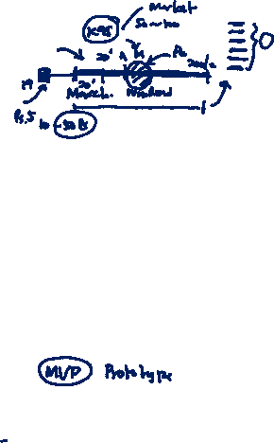
Who is an Entrepreneur?
Entrepreneurship is the pursuit of opportunity beyond resources controlled – Professor Howard Stevenson
“Pursuit” implies a singular, relentless focus
Entrepreneurs often perceive a short window of opportunity
They need to show tangible progress to attract resources, and the mere passage of time consumes limited cash balances

Slide 3

Who is an Entrepreneur?
Entrepreneurship is the pursuit of opportunity beyond resources controlled – Professor Howard Stevenson
“Opportunity” implies an offering that is novel in one or more of four ways.
The opportunity may entail:
pioneering a truly innovative product;
devising a new business model;
creating a better or cheaper version of an existing product; or
targeting an existing product to new sets of customers.
These opportunity types are not mutually exclusive.

Slide 4

Who is an Entrepreneur?
Entrepreneurship is the pursuit of opportunity beyond resources controlled – Professor Howard Stevenson
“Beyond resources controlled” implies resource constraints.
At a new venture’s outset, its founders control only their own human, social, and financial capital.
Many entrepreneurs bootstrap: they keep expenditures to a bare minimum while investing only their own time and, as necessary, their personal funds. In some cases, this is adequate to bring a new venture to the point where it becomes self-sustaining from internally generated cash flow.
With most high-potential ventures, however, founders must mobilize more resources than they control personally: the venture eventually will require production facilities, distribution channels, working capital, and so forth.

Slide 5
Risks and Entrepreneur?
Entrepreneurs face considerable risk, which comes in four main types.
Demand risk relates to prospective customers’ willingness to adopt the solution envisioned by the entrepreneur.
Technology risk is high when engineering or scientific breakthroughs are required to bring a solution to fruition.
Execution risk relates to the entrepreneur’s ability to attract employees and partners who can implement the venture’s plans.
Financing risk relates to whether external capital will be available on reasonable terms.
The entrepreneur’s task is to manage this uncertainty, while recognizing that certain risks cannot be influenced by their actions.

Slide 6
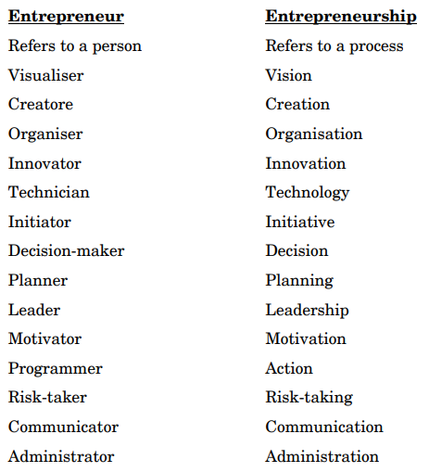

Entrepreneur and Entrepreneurship
entrepreneur is one who creates his own business i.e., a person who organizes, operates and assumes the risk of a business venture
entrepreneurship refers to a process of action an entrepreneur undertakes to establish his enterprise
The entrepreneur is essentially a business leader and the functions performed by him are entrepreneurship

Slide 7
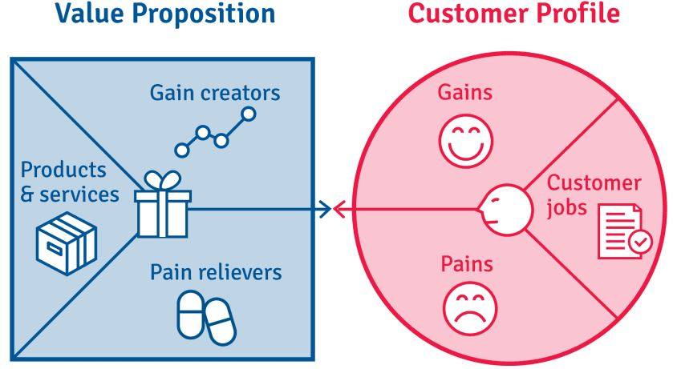
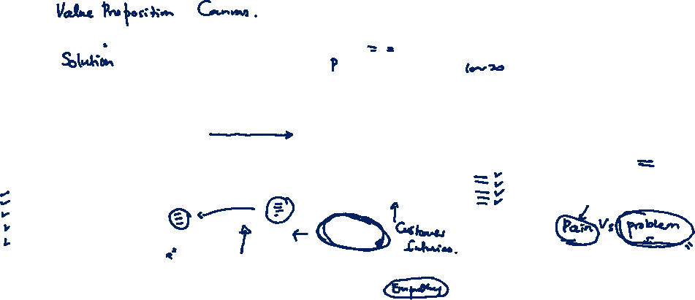
Value Proposition
All businesses have a single common attribute. They create value by addressing customers’ pains.
“A value proposition should clearly explain how a product fills a need, communicate the specifics of its added benefit, and state the reason why it's better than similar products on the market” - Investopedia
Notes:
https://www.b2binternational.com/research/methods/faq/what-is-the-value-proposition-canvas/

Slide 8
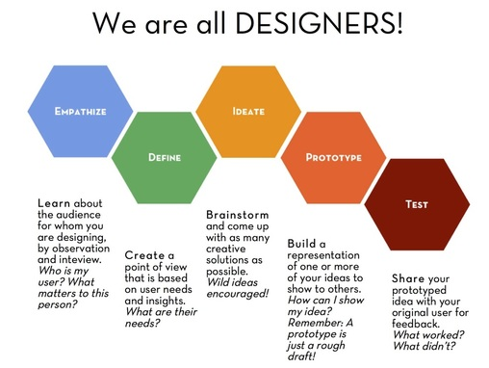
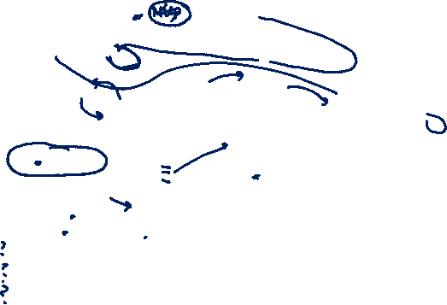
Design Thinking

Slide 9
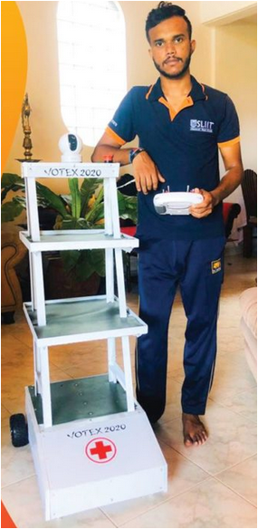

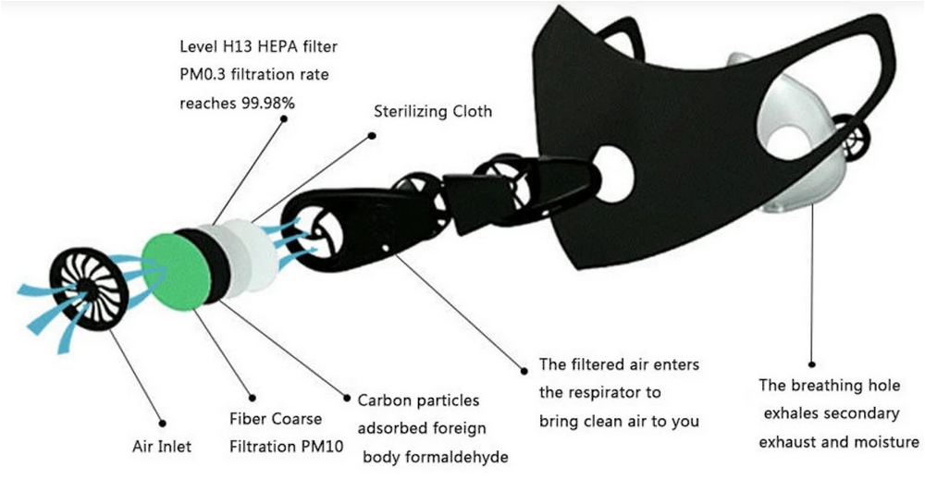
Value Proposition

Slide 10

Key Success Factors
Key Success Factors
Skills, Expertise & Aptitude
Personal Attributes
Strong Management Skills
External Factors

Slide 11
Key Success Factors
Key Success Factors
Skills, Expertise & Aptitude
Personal Attributes
Strong Management Skills
External Factors

Slide 12
Skills, Expertise, and Aptitude
Strong particular skills, expertise and aptitudes that can be applied profitably in enterprise.
Skills
Usually refers to manual work, can be learned.
Become an electrician, hairdresser
Expertise
Based on knowledge that you acquire
Obtained from studying and/or experience
Aptitude and talents
What you are born with/talents
Notes:
Leadership and Motivation:
Can you lead and motivate others to follow you and deliver your vision? And are you able to delegate work to others? As a successful entrepreneur, you'll have to depend on others to get beyond a very early stage in your business – there's just too much to do all on your own!
Communication Skills:
Are you competent with all types of communication ? You need to be able to communicate well to sell your vision of the future to investors, potential clients, team members, and more.
Listening:
Do you hear what others are telling you? Your ability to listen can make or break you as an entrepreneur. Make sure that you're skilled at active listening and empathetic listening.
Creative Thinking:
Are you able to see situations from a variety of perspectives and come up with original ideas? (There are many creativity tools that will help you do this.)
Problem Solving:
How good are you at coming up with sound solutions to the problems you're facing? Tools such as Cause & Effect Analysis , the 5 Whys Technique, and CATWOE are just some of the problem-solving tools that you'll need to be familiar with.
Recognizing Opportunities:
Do you recognize opportunities when they present themselves? Can you spot a trend ? And are you able to create a plan to take advantage of the opportunities you identify?
Goal Setting:
Do you regularly set goals , create a plan to achieve them, and then carry out that plan?
Planning and Organizing:
Do you have the talents, skills, and abilities necessary to achieve your goals? Can you coordinate people to achieve these efficiently and effectively? (Here, effective project management skills are important, as are basic organization skills.) And do you know how to develop a coherent, well thought-through business plan , including developing and learning from appropriate financial forecasts ?
Decision Making:
How good are you at making decisions? Do you make them based on relevant information and by weighing the potential consequences? And are you confident in the decisions that you make?
Create/Maintain Personal Relations:
Are you emotionally intelligent? The higher your EI, the easier it will be for you to work with others. The good news is that you can improve your emotional intelligence!
Negotiation:
Are you a good negotiator ? Not only do you need to negotiate keen prices, you also need to be able to resolve differences between people in a positive, mutually beneficial way.
Ethics:
Do you deal with people based on respect, integrity , fairness, and truthfulness? Can you lead ethically ? You'll find it hard to build a happy, committed team if you deal with people – staff, customers or suppliers.

Slide 13
Key Success Factors
Key Success Factors
Skills, Expertise & Aptitude
Personal Attributes
Strong Management Skills
External Factors

Slide 14

Personal Attributes: Common Characteristics
Passion and Motivation
Not Afraid to Take Risks - Risk takers
Self-belief, Hard Work and Disciplined Dedication
Adaptable and Flexible
Product and Market Knowledge
Strong Money Management
Effective Planning (Not Over-Planning) Skills
The Right Connections
Exit Preparedness
Ability to Question Themselves
Original thinkers
Take responsibility for own actions
Feel competent and capable
Set high goals and enjoy working toward them

Slide 15
Personal Attributes: Common Characteristics
Successful
Creative and Innovative
Position themselves in shifting or new markets
Create new products
Create new processes
Create new delivery
Unsuccessful
Poor Managers
Low work ethic
Inefficient
Failure to plan and prepare
Poor money managers

Slide 16
Personal Attributes
Entrepreneurs are Made, Not Born!
Many of these key attributes are developed early in life, with the family environment playing an important role
Entrepreneurs tend to have had self employed parents who tend to support and encourage independence, achievement, and responsibility
Firstborns tend to have more entrepreneurial attributes because they receive more attention, have to forge their own way, thus creating higher self-confidence
Entrepreneurial Careers
The idea that entrepreneurial success leads to more entrepreneurial activity may explain why many entrepreneurs start multiple companies over the course of their career
Corridor Principle- Using one business to start or acquire others and then repeating the process
Serial Entrepreneurs- A person who founds and operates multiple companies during one career

Slide 17
Key Success Factors
Key Success Factors
Skills, Expertise & Aptitude
Personal Attributes
Strong Management Skills
External Factors

Slide 18
Strong Management Skills
Time Management
Employee Management
Customer Management
Sales Management
Financial Management
Business Management

Slide 19
Key Success Factors
Key Success Factors
Skills, Expertise & Aptitude
Personal Attributes
Strong Management Skills
External Factors

Slide 20
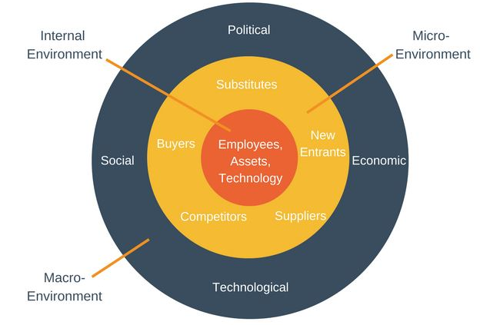
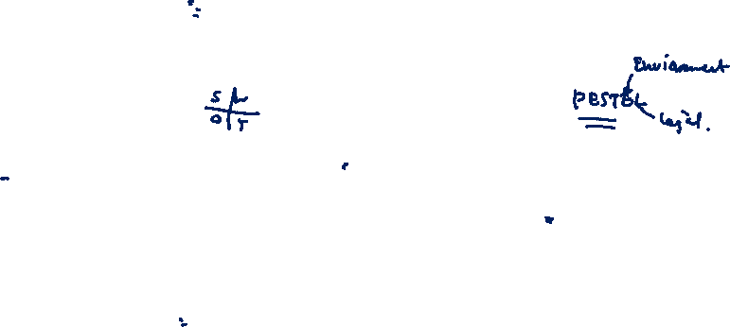
Business Environment
PEST Analysis followed by a SWOT Analysis helps an organization to develop business strategy

Slide 21
External Factors
Political
- Government Policies
- Current Legislations
- Pressure groups
- Wars and conflicts
Social
- Lifestyle trends
- Demographics
- Consumer opinions
- Media views
- Role models
Economic
- Home economic situation
- Home economic trends
- Interest/Exchange rates
- Taxation
Technological
- Competing technologies
- Research funding
- Innovation potential
- IP issues
- Consumer buying mechanisms

Slide 22
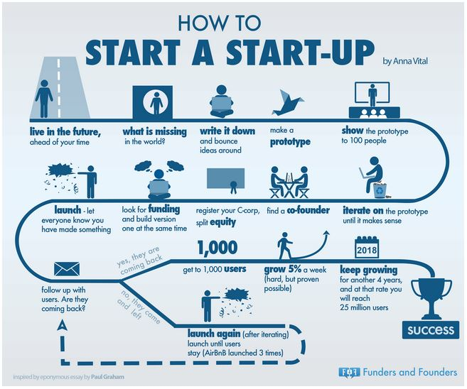

How to Launch a Startup

Slide 23
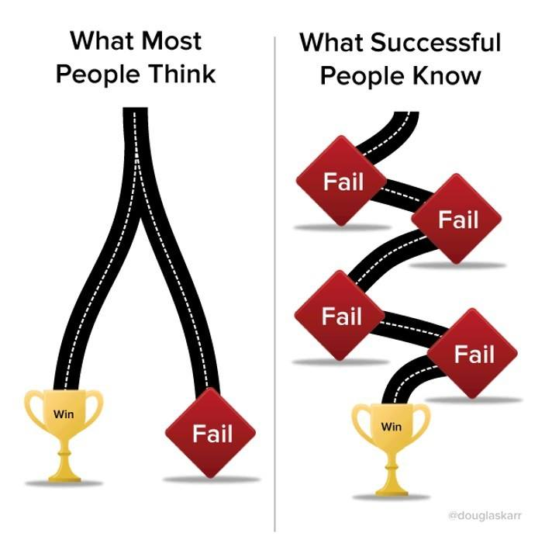
Image credit: Ganindu Nanayakkara, second-runner up in the Transportation category of the Verizon Powerful Answers Award

Slide 24
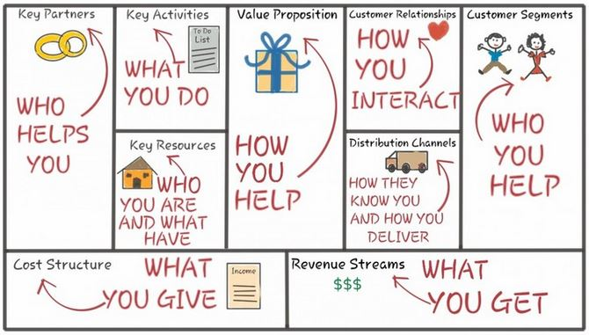
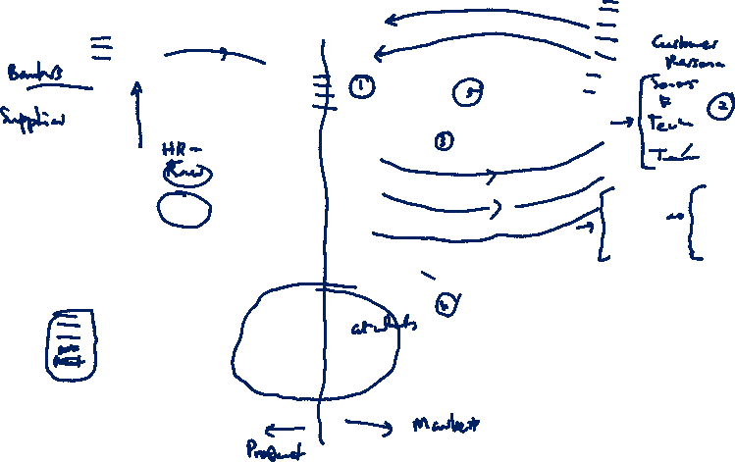
Business Model Canvas
Alex Osterwalder

Slide 25
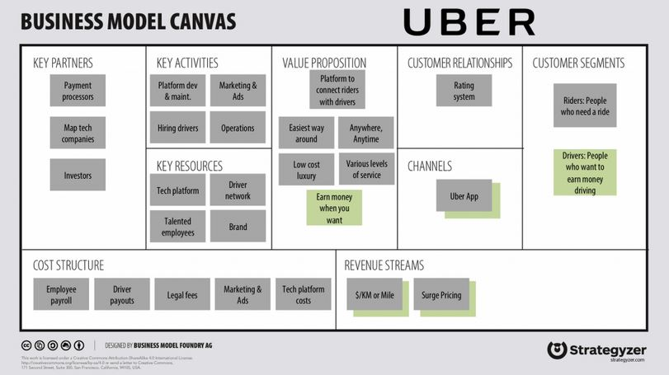


Slide 26
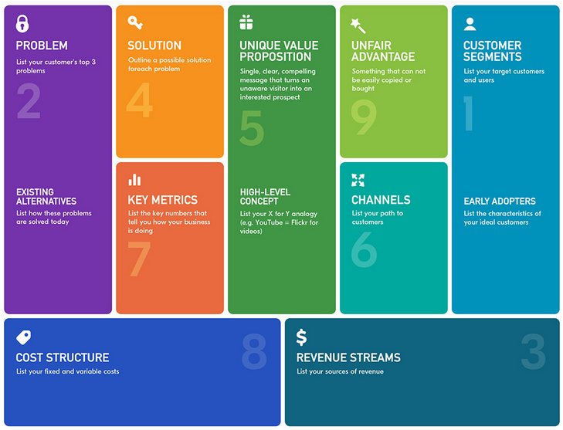

Lean Canvas
Lean Canvas is a 1-page business plan template created by Ash Maurya, adopted from BMC.

Slide 27

Group Work
How to commercialize your 2nd Year project?
- Value proposition
- SWOT Analysis
- PEST Analysis
- Strategies
- Lean Canvas

Slide 28
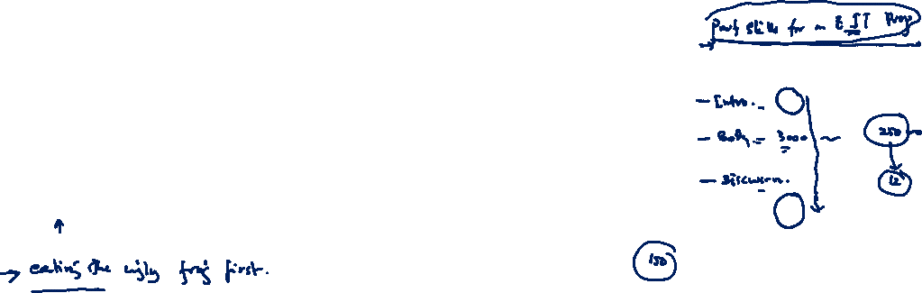
Submission
No Submission.
Thank You.

